Slide 1
Process Scheduling
Basic Concepts
Scheduling Criteria
Scheduling Algorithms
Real-Time Scheduling
Algorithm Evaluation
Process Scheduling Models

Slide 2

Scheduling

Slide 3
Basic Concepts
CPU scheduling is the basis of multi-programmed OS.
In the uni-processor system only one process runs at a time. Other processes must wait until CPU is free and can be rescheduled.
Idea: the process is executed until it must wait for completion of I/O request.
When one process has to wait, OS takes CPU away from that process and gives the CPU to another process.
All the computer resources are schedules before use.
Maximum CPU utilization obtained with multiprogramming
CPU–I/O Burst Cycle – Process execution consists of a cycle of CPU execution and I/O wait.
CPU burst distribution

Slide 4

Observed property
Process execution consists of a cycle of execution and I/O wait.
CPU–I/O Burst Cycle – Process execution consists of a cycle of CPU execution and I/O wait.
Process execution starts with CPU-burst. That is followed by I/O burst.
The execution ends with CPU burst.
CPU burst distribution

Slide 5

Histogram of CPU-burst Times
Many short CPU bursts and a few long CPU bursts.

Slide 6
CPU and I/O bound processes
An I/O bound program would have many short CPU bursts.
A CPU bound program would have long CPU bursts.

Slide 7
CPU Scheduler
Selects from among the processes in memory that are ready to execute, and allocates the CPU to one of them.
Short-term scheduler
CPU scheduling decisions may take place when a process:
  1. Switches from running to waiting state (due to I/O).
  Switches from running to ready state (due to interrupt)
  3. Switches from waiting to ready. (Completion of I/O)
  4. Terminates.
Scheduling under 1 and 4 is non-preemptive.
  Once a CPU has been allocated to a process, the process keeps the CPU until it releases the CPU either by terminating or by switching to the waiting state.
    WINDOWS 3.1 and MAC
All other scheduling is preemptive.
  The process can be preempted and another process can be run.
    UNIX
    Difficult to implement.
    (Refer the book for the issues)

Slide 8
Designing Preemptive Scheduling based OS is difficult
It incurs cost to access shared data
Affects the design of OS
  Interrupts occcur at arbitrary time, changing of data modified by kernel
Section of code modified by interrupts should be guarded
But, all modern OSs are preemptive scheduling due to performance advantages as compared to non- preemtive scheduling

Slide 9
Dispatcher
Dispatcher module gives control of the CPU to the process selected by the short-term scheduler; this involves:
  switching context
  switching to user mode
  jumping to the proper location in the user program to restart that program
Dispatch latency – time it takes for the dispatcher to stop one process and start another running.

Slide 10
Scheduling Criteria
Scheduling algorithm favors one process to another.
User oriented criteria
  Turnaround time – amount of time to execute a particular process
    The interval from the time of submission of a process to the time of completion.
    The sum of periods spent in waiting to get into memory, waiting in the ready queue, executing on CPU and doing I/O
  Response time – amount of time it takes from when a request was submitted until the first response is produced, not output (for time-sharing environment)
  Deadlines: When the process completion deadlines can be specified, the scheduling discipline should subordinate their goals to that of maximizing the percentage of deadlines met.

Slide 11
Scheduling Criteria
System oriented
  Throughput – # of processes that complete their execution per time unit
  CPU utilization – keep the CPU as busy as possible; percentage of time the processor is busy.
    It may range from 0 to 100 percent.
    In a real system, it should range from 40 percent (lightly loaded) to 90 percent (heavily loaded)
  Waiting time: It is the sum of the periods spent waiting in the ready queue.
System oriented: other
  Fairness: In the absence of guidance from user or other system supplied guidance, processes should be treated the same, and no process should suffer starvation.
  Enforcing priorities: When processes are assigned priorities, the scheduling policy should favor higher priority processes.
  Balancing resources: The scheduling policy should keep the resources of the system busy. Processes that underutilize the stressed resources should be favored which involves long term scheduling.

Slide 12
Optimization Criteria
Maximize
  CPU utilization
  Throughput
Minimize
  turnaround time
  waiting time
  response time
    (Some suggest variance of response time)

Slide 13
Scheduling Algorithms
FIFO
SJF
Priority
Round Robin
Multilevel
Multilevel feedback

Slide 14
First-Come, First-Served (FCFS) Scheduling
The process that requests CPU first is allocated the CPU first. Process Burst Time
P₁ 24
P₂ 3
P₃ 3
Suppose that the processes arrive in the order: P₁ , P₂ , P₃
The Gantt Chart for the schedule is:
Waiting time for P₁ = 0; P₂ = 24; P₃ = 27
Average waiting time: (0 + 24 + 27)/3 = 17
P₁
P₂
P₃
0
24
27
30

Slide 15
FCFS Scheduling (Cont.)
Suppose that the processes arrive in the order
P₂ , P₃ , P₁ .
The Gantt chart for the schedule is:
Waiting time for P₁ = 6; P₂ = 0; P₃ = 3
Average waiting time: (6 + 0 + 3)/3 = 3
Much better than previous case.
Dynamic environment
  Convoy effect: short process behind long process
P₂
P₃
P₁
0
3
6
30

Slide 16
FCFS Scheduling (Cont.)
Scenarios
  One CPU bound process and many I/O bound process
  CPU bund process will hold the CPU for a long time
  All I/O processes are in ready queue
    The I/O devices are idle
  This is a convoy effect
    Several processes wait for one big process.
FCFS algorithm is non-preemptive
Positive Points
  code is simple to write and understand
Negative points
  It is not good for timesharing systems
  Average waiting time may be too long.
  Convoy effect results in lower CPU and device utilization.
  Penalizes short processes; penalizes I/O bound processes
  Response time may be high, especially there is a large variance in process execution times.

Slide 17
Shortest-Job-First (SJF) Scheduling
When CPU is available it is assigned to the process that has the smallest next CPU burst.
If the bursts are equal, FCFS is used to break the tie.
Associate with each process the length of its next CPU burst. Use these lengths to schedule the process with the shortest time.
Two schemes:
  Non-preemptive – once CPU is given to the process it cannot be preempted until it completes its CPU burst.
  Preemptive – if a new process arrives with CPU burst length less than remaining time of current executing process, preempt. This scheme is know as Shortest-Remaining-Time-First (SRTF).
SJF is optimal – gives minimum average waiting time for a given set of processes.

Slide 18
Example of Non-Preemptive SJF
Process Arrival Time Burst Time
P₁ 0.0 7
P₂ 2.0 4
P₃ 4.0 1
P₄ 5.0 4
SJF (non-preemptive)
Average waiting time = (0 + 6 + 3 + 7)/4 = 4
P₁
P₃
P₂
P₄
0
3
7
8
12
16

Slide 19
Example of Preemptive SJF
Process Arrival Time Burst Time
P₁ 0.0 7
P₂ 2.0 4
P₃ 4.0 1
P₄ 5.0 4
SJF (preemptive)
Average waiting time = (9 + 1 + 0 +2)/4 = 3
P₁
P₂
P₃
P₂
P₄
P₁
0
2
4
5
7
11
16

Slide 20
Determining Length of Next CPU Burst
Difficulty: Knowing the next CPU burst of each process.
Solution: approximation.
Simplest approximation: running average of each “burst” for each process.
  τ_{n+1}=1/n ∑t_{i} (i=1 to n)
  Where, t_{i} processor execution time for the i’th instance of this process (processor execution time for batch job, processor burst time for interactive job)
  τ_{i}; predicted value for the ith instance
  τ1;predicted value for the first instance (not calculated)
To avoid recalculating the entire summation each time we can rewrite τ_{n+1} =1/n t_{n} + (n-1)/n τ_{n}
The above formula gives equal weight to each instance
Normally most recent references likely reflect future behavior
Common technique is exponential averaging.

Slide 21
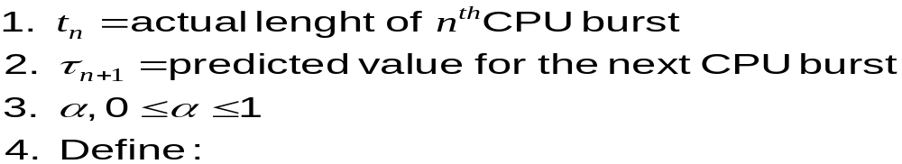
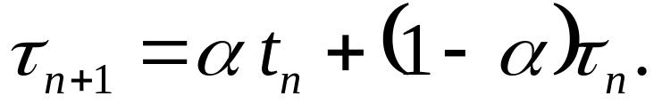
Exponential averaging

Slide 22

Prediction of the Length of the Next CPU Burst

Slide 23
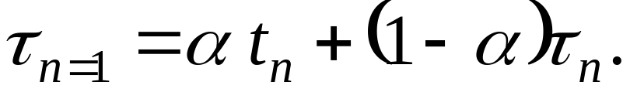
Examples of Exponential Averaging
α =0
  τ_{n+1} = τ_{n} ; Recent history does not count.
  If α → 0; greater weight is given to past values.
  If α → 1; greater weight is given to recent values.
α =1
  τ_{n+1} = t_{n}
  Only the actual last CPU burst counts.
If we expand the formula, we get:
    τ_{n+1} = α t_{n}+(1 - α) α t_{n} ₋₁ + …
    +(1 - α )^{j} α t_{n} _{-i} + …
    +(1 - α )^{n+1} τ₀
Since both α and (1 - α) are less than or equal to 1, each successive term has less weight than its predecessor.
If α =0.8, then τ_{n+1} = 0.8 t_{n}+0.16 t_{n} ₋₁ + 0.032 t_{n} ₋₂ + …

Slide 24
Priority Scheduling
A priority number (integer) is associated with each process
The CPU is allocated to the process with the highest priority (smallest integer ≡ highest priority).
Equal priority process is scheduled in FCFS order.
SJF is a priority scheduling where priority is the predicted next CPU burst time.

Slide 25
Example: Priority scheduling
Process Burst time Priority
P₁ 10 3
P₂ 1 1
P₃ 2 3
P₄ 1 4
P₅ 5 2
Priority
Average waiting time = 8.2 msec
P2
P5
P1
P3
P4
0
1
6
16
18
19

Slide 26
Priority scheduling…
Priority scheduling can be either preemptive or non-preemptive.
A preemptive priority scheduling algorithm will preempt the CPU if the priority of the newly arrived process is higher than the priority of the currently running process.
A non-preemptive priority scheduling algorithm will simply put the new process at the head of the ready queue.

Slide 27
Priority scheduling: Problem
Problem ≡ Starvation – low priority processes may never execute.
In an heavily loaded system, a stream of high priority processes can prevent low priority process from ever getting the CPU.
Solution ≡ Aging – as time progresses increase the priority of the process.
  Ex: if priorities range from 0 (low)-127 (high), every 15 minutes we can increment the priority of the waiting process.

Slide 28
Round Robin (RR)
Each process gets a small unit of CPU time (time quantum), usually 10-100 milliseconds. After this time has elapsed, the process is preempted and added to the end of the ready queue.
The ready queue is treated as a circular queue.
  If the CPU burst is less than 1 time quantum, the process leaves the system.
  If the CPU burst is greater than the time quantum, interrupt occurs and context switch will be executed.
If there are n processes in the ready queue and the time quantum is q, then each process gets 1/n of the CPU time in chunks of at most q time units at once. No process waits more than (n-1)q time units.

Slide 29
Example of RR with Time Quantum = 20
Process Burst Time
P₁ 53
P₂ 17
P₃ 68
P₄ 24
The Gantt chart is:
Typically, higher average turnaround than SJF, but better response.
P₁
P₂
P₃
P₄
P₁
P₃
P₄
P₁
P₃
P₃
0
20
37
57
77
97
117
121
134
154
162

Slide 30

Round Robin Performance
Performance depends on the size of the time quantum.
If the time quantum is large, RR policy is the same as the FCFS policy.
If the time quantum is too small, there will be more number of context switches.

Slide 31

RR performance..
If the context switch time is 10 % of time quantum, then 10 % of CPU time will be spent on the context switch.
However, if we increase the time quantum the average turnaround time may not be improved.
In general the average turnaround time will be improved if process finishes next CPU burst within single time quantum.
Performance Summary:
  q large ⇒ FIFO
  q small ⇒ more number of context switches.
  q must be large with respect to context switch, otherwise overhead is too high.
Rule of thumb: 80 % of the CPU bursts should be shorter than the time quantum.

Slide 32
Multilevel Queue
Ready queue is partitioned into several separate queues:
Example: foreground (interactive); background (batch)
  Foreground processes may have priority over background processes.
Each queue has its own scheduling algorithm,
foreground – RR
background – FCFS
Scheduling must be done between the queues.
  Fixed priority scheduling; (i.e., serve all from foreground then from background). Possibility of starvation.
  Time slice – each queue gets a certain amount of CPU time which it can schedule amongst its processes; i.e., 80% to foreground in RR
  20% to background in FCFS

Slide 33

Multilevel Queue Scheduling

Slide 34
Multilevel Queue
Each queue has absolute priority over lower-priority queues.
  No process in the batch queue can run unless the above queues are empty.
  If the interactive process enters while the batch process is running, the batch process would be preempted.
  Solaris 2 uses a form of this algorithm.
Another policy is time slice:
  Each queue gets certain portion of CPU time.
    The foreground queue may receive 80% of CPU time, and background queue receives 20% of CPU time.
Aging: A process can move between the various queues; aging can be implemented this way.

Slide 35
Multilevel Feedback Queue Scheduling
Process moving is allowed
The basic idea is to separate processes with different CPU-burst characteristics.
  If a process uses too much CPU time, it will be demoted to lower priority queue.
  If a process waits too long, it will be promoted to higher priority queue.
    Aging prevents starvation

Slide 36

Example of Multilevel Feedback Queue
Three queues:
  Q₀ – time quantum 8 milliseconds
  Q₁ – time quantum 16 milliseconds
  Q₂ – FCFS
Scheduling
  A new job enters queue Q₀ which is served FCFS. When it gains CPU, job receives 8 milliseconds. If it does not finish in 8 milliseconds, job is moved to queue Q₁.
  At Q₁ job is again served FCFS and receives 16 additional milliseconds. If it still does not complete, it is preempted and moved to queue Q₂.
The process that arrives in Q₀ will preempt a process in Q_{2.}
Highest priority is given to the process of having 8 msec CPU burst.

Slide 37
Multilevel Feedback Queue Scheduling
Multilevel-feedback-queue scheduler defined by the following parameters:
  number of queues
  scheduling algorithms for each queue
  method used to determine when to upgrade a process
  method used to determine when to demote a process
  method used to determine which queue a process will enter when that process needs service
Multi-level is a general scheduling algorithm
It can be configured to match a specific system under design.
  It requires some means of selecting the values for all the parameters.

Slide 38
Thread Scheduling
Distinction between user-level and kernel-level threads
When threads supported, threads scheduled, not processes
Many-to-one and many-to-many models, thread library schedules user-level threads to run on LWP
  Known as process-contention scope (PCS) since scheduling competition is within the process
  Typically done via priority set by programmer
Kernel thread scheduled onto available CPU is system-contention scope (SCS) – competition among all threads in system

Slide 39
Pthread Scheduling
API allows specifying either PCS or SCS during thread creation
  PTHREAD_SCOPE_PROCESS schedules threads using PCS scheduling
  PTHREAD_SCOPE_SYSTEM schedules threads using SCS scheduling
Can be limited by OS – Linux and Mac OS X only allow PTHREAD_SCOPE_SYSTEM

Slide 40
Multi-threading
Multithreading refers to the ability on an operating system to support multiple threads of execution within a single process.
Traditionally there is s single thread of execution per process.
  Example: MSDOS supports a single user process and single thread.
  UNIX supports multiple user processes but only support one thread per process.
Multithreading
  Java run time environment is an example of one process with multiple threads.
  Examples of supporting multiple processes, with each process supporting multiple threads
    Windows 2000, Solaris, Linux, Mach, and OS/2
Instruction
trace
One process one thread
One process multiple threads
Multiple processes,
multiple threads per process
Multiple processes,
one thread per process

Slide 41
Pthread Scheduling API
#include <pthread.h>
#include <stdio.h>
#define NUM THREADS 5
int main(int argc, char *argv[])
{
int i;
pthread t tid[NUM THREADS];
pthread attr t attr;
/* get the default attributes */
pthread attr init(&attr);
/* set the scheduling algorithm to PROCESS or SYSTEM */
pthread attr setscope(&attr, PTHREAD SCOPE SYSTEM);
/* set the scheduling policy - FIFO, RT, or OTHER */
pthread attr setschedpolicy(&attr, SCHED OTHER);
/* create the threads */
for (i = 0; i < NUM THREADS; i++)
pthread create(&tid[i],&attr,runner,NULL);

Slide 42
Pthread Scheduling API
/* now join on each thread */
for (i = 0; i < NUM THREADS; i++)
pthread join(tid[i], NULL);
}
/* Each thread will begin control in this function */
void *runner(void *param)
{
printf("I am a thread\n");
pthread exit(0);
}

Slide 43
Multiple-Processor Scheduling
CPU scheduling more complex when multiple CPUs are available
Homogeneous processors within a multiprocessor
  The processors are identical
Asymmetric multiprocessing – only one processor accesses the system data structures, alleviating the need for data sharing
    Master server,
    simple to implement
Symmetric multiprocessing (SMP) – each processor is self-scheduling, all processes in common ready queue, or each has its own private queue of ready processes
  Currently, most common
Processor affinity – process has affinity for processor on which it is currently running
  soft affinity: Efforts will be made to run the process on the same CPU, but not guaranteed.
  hard affinity: Process do not migrate among the processors.
  Variations including processor sets
    Processor set is assigned to a process. It can run on any processor.

Slide 44
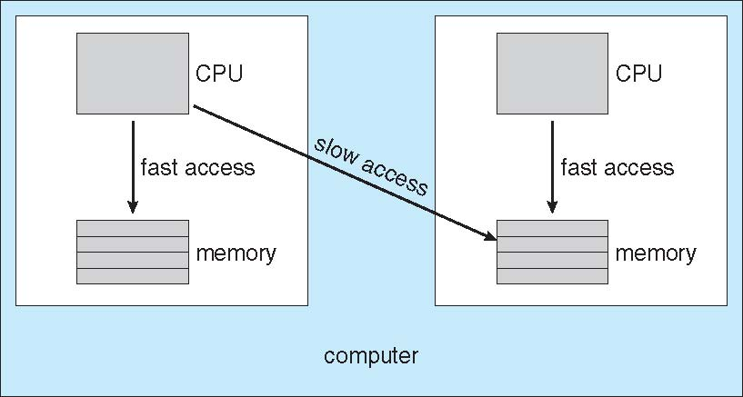
NUMA and CPU Scheduling
NUMA: Non-Uniform Memory Access : CPU has faster access to some parts of main memory than to other parts. It occurs in the systems with combined CPU and memory boards.
Note that memory-placement algorithms can also consider affinity

Slide 45
Multiprocessor Scheduling: Load Balancing
Load balancing attempts to keep the workload evenly distributed across all the processors in an SMP system.
Push migration and pull migration
  Push migration
    A specific process periodically checks the load on each processor and evenly distributes the processes.
  Pull migration
    Idle processor pulls a waiting task from a busy processor.

Slide 46
Multicore Processors
Recent trend to place multiple processor cores on same physical chip
Faster and consumes less power
Multiple threads per core also growing
  Memory stall: When a processor accesses main memory, it spends significant amount of time in waiting.
  Takes advantage of memory stall to make progress on another thread while memory retrieve happens

Slide 47


Multithreaded Multicore System
Two threads are associated with one core
One core may have many logical processors
A dual core may have four logical processors

Slide 48
LINUX
Two separate process scheduling algorithms
  Time sharing algorithm for fair preemptive scheduling among multiple processes.
  Other is designed for real-time tasks
LINUX allows only user processes to preempt
A process can not be preempted in kernel mode, even real-time process is available to run.
Every process is assigned with scheduling class, that defines which of the algorithms to apply to the process.
First class is for time—sharing processes
  LINUX uses prioritized credit based algorithm
  Each process posses a certain number of scheduling credits.
  While choosing, the process with most credits is selected.
  Every time the interrupt occurs the process loses one credit
  When its credits reaches zero it is suspended and another process is chosen.

Slide 49
LINUX ( earlier than 2.5)
If no runnable process have any credits, LINUX performs re-crediting operation. It adds credits to every process
  Credits=(Credits/2)+priority
This algorithm uses two factors: process history and priority.
Suspended process will accumulate more credits.
It also gives high priority to interactive processes
Linux implements two real-time scheduling classes
  FCFS and round robin.
In the FCFS class the process runs until it blocks.
LINUX real-time scheduling is soft—rather than hard.
The scheduler guarantees priorities, but kernel never gives guarantees
  Kernel process can not preempted

Slide 51
Real-Time Scheduling
Hard real-time systems – required to complete a critical task within a guaranteed amount of time.
Soft real-time computing – requires that critical processes receive priority over less fortunate ones.

Slide 52
Hard real-time systems
Process is submitted along with a statement of amount of time in which it needs to complete or I/O.
The scheduler may admit the process or reject the process as impossible.
The main concept is resource reservation.
  The scheduler must know exactly how long each OS function takes to perform.
It is difficult to realize this guarantee on general purpose OSs.
Therefore , hard real-time systems are composed of special purpose software running on hardware dedicated to their critical process.

Slide 53
Soft real-time systems
Computing is less restrictive.
Requires that critical process should receive priority over lesser priority processes.
Adding soft real-time functionality may cause problems
  Unfair allocation of resources may result in longer delays or even starvation for some processes.
A soft real-time system is nothing but a general purpose OS that can also support multimedia, high-speed interactive graphics and so on.
  Multimedia and high-speed interactive graphics would not work acceptably in an environment that does not support soft real-time computing.

Slide 54
Soft real-time systems…
Implementation requires careful design of the scheduler and other related aspects.
System must have priority scheduling.
Real time processes must receive highest priority and priority should not degrade over time.
  Aging is disallowed
Dispatch latency must be small.
  Which is very difficult as some system calls are complex.
  For example, many OSs are forced to wait for a system call to complete to execute context switch.
  So to keep dispatch latency low, insertion of preemption points in system call code is one solution.
  At preemption point, the process checks whether any high priority process is waiting.
  Another method is to make entire kernel pre-emptable.

Slide 55
Soft real-time systems…
If higher priority process needs to read or modify kernel data which is currently accessed by lower priority process, then higher priority process would be waiting for a lower priority process to finish.
This problem can be solved with priority-inheritance protocol
  All the process which are sharing a resource with high priority processes inherit the high priority until they are done with that resource.
  After finishing, priority reverts to original value.
So the conflict phase of dispatch latency has two components
  Preemption of any process running in the kernel
  Release by low-priority process resources needed by high-priority resources.
    In Solaris dispatch latency with preemption is 2 msec and without preemption is 100 msec.

Slide 56

Dispatch Latency

